Slide 1

CPEN 211: Introduction to Microcomputers Slide Set 1: The Digital Abstraction Combinational Logic Verilog
Prof. Tor Aamodt
By Unknown - U.S. Army Photo, Public Domain, https://commons.wikimedia.org/w/index.php?curid=55124
Notes:
0.5

Slide 2
Today, almost all electronics represents information digitally (e.g., using 0’s and 1’s). Why?

Slide 3
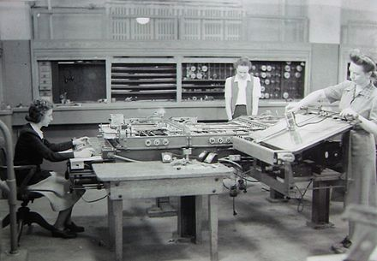
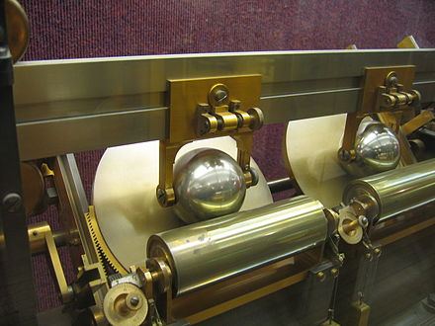
Differential Analyzer (c. 1942)

Slide 4
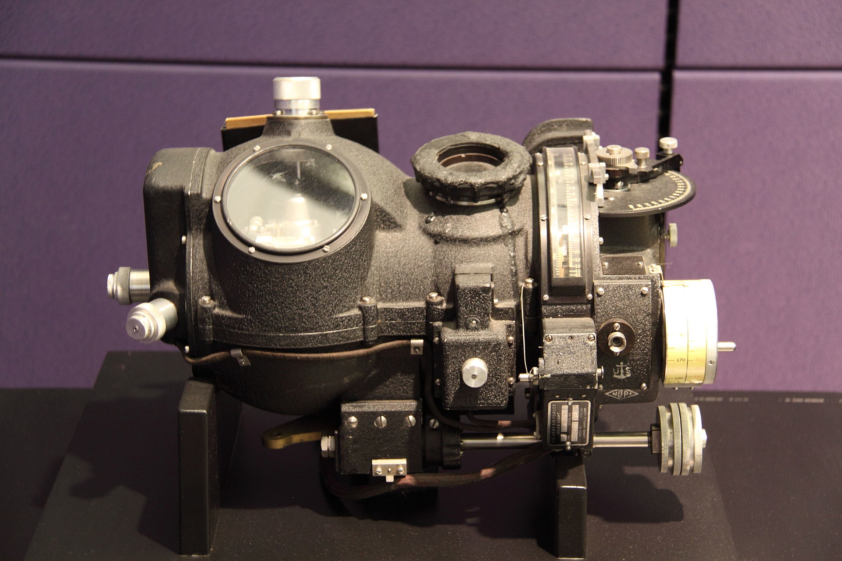
More Analog Computers…
Norden bombsight [Computer History Museum]
Notes:
1

Slide 5
Learning Objectives
By the end of this slide set you should be able to:
Describe simple logic circuits using Verilog
Explain how noise motivates the use of digital signals in computing systems
Define combinational logic and explain how to build larger combinational logic circuits out of smaller combinational logic circuits
Apply boolean logic to simplify logical expressions
Notes:
1

Slide 6
Reading (Dally)
Slide Set 1: Chapter 1, 3, 7.1, 10.1, App. A
Slide Set 2: Chapter 6, 7, 8.5

Slide 7
What is Verilog?
It is NOT a programming language!
It is a hardware description language (HDL)
Used as an input to:
Synthesis – implement hardware with gates, cells, or FPGAs
Simulation – see what your hardware will do before you build it
Text: Dally §1.5
Notes:
In this course, we use Verilog to describe hardware.
Before talking about syntax I want to give you some context on how Verilog is used.
Not software: Reading novel vs. describing how to build a house not with a blue print but words.
Same code used in two ways
Simulation => ModelSim – this is very close to running the Verilog code as if it where a program.
Synthesis => Quartus – this is different. Here the tool tries to figure out which hardware behaves the same as your description. In general, synthesis is a very hard problem and that means we need to be careful about how we write Verilog.

Slide 8

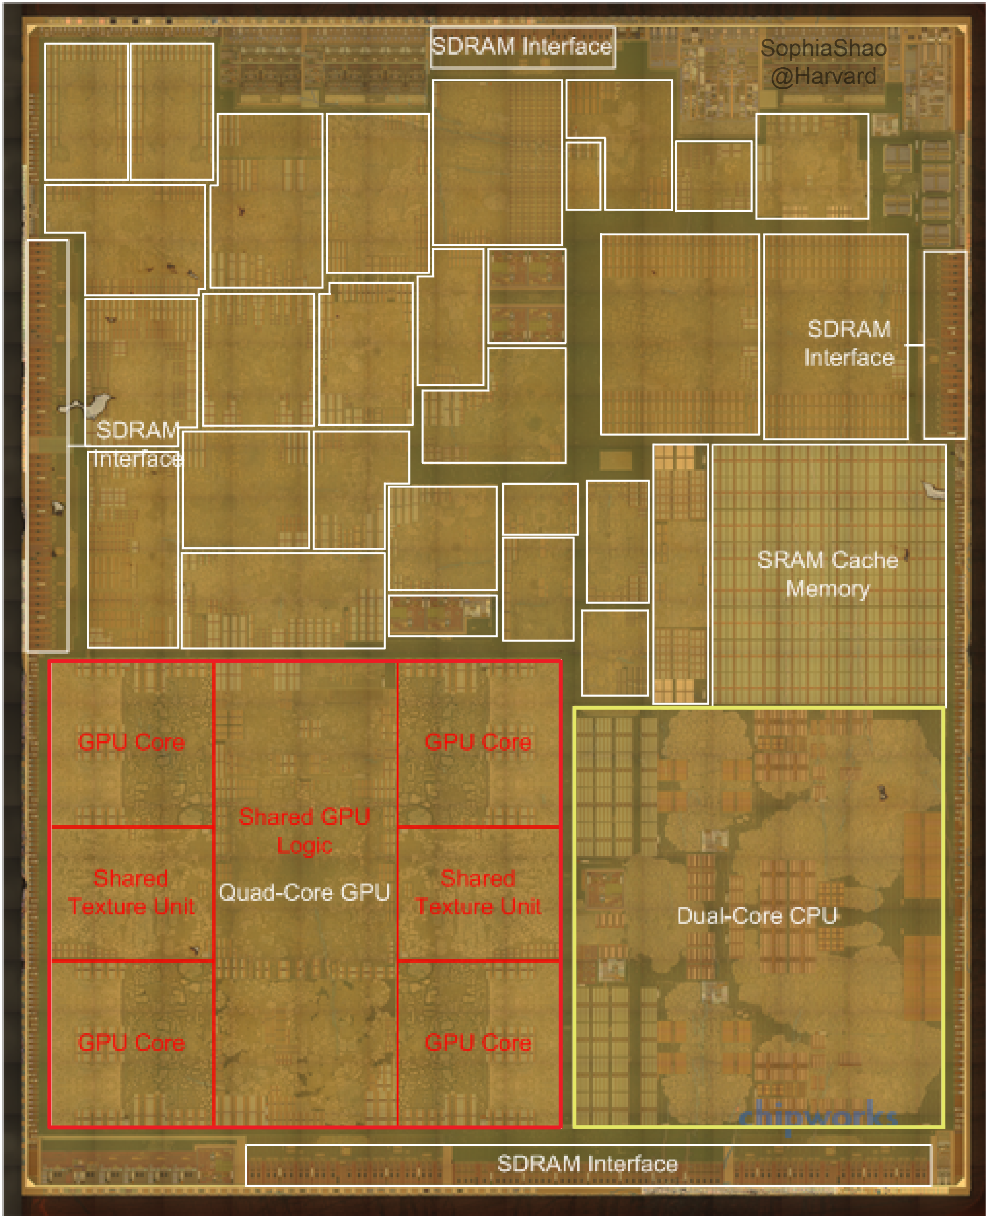
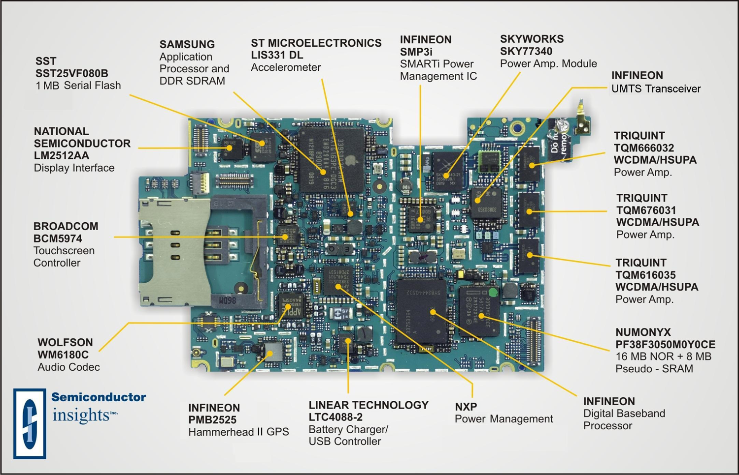
Apple A8 die photo
(application processor
used in iPhone 6)
[http://vlsiarch.eecs.harvard.edu/accelerators/die-photo-analysis]
Notes:
Verilog is used as an input to synthesis tools to create chips like these.

Slide 9
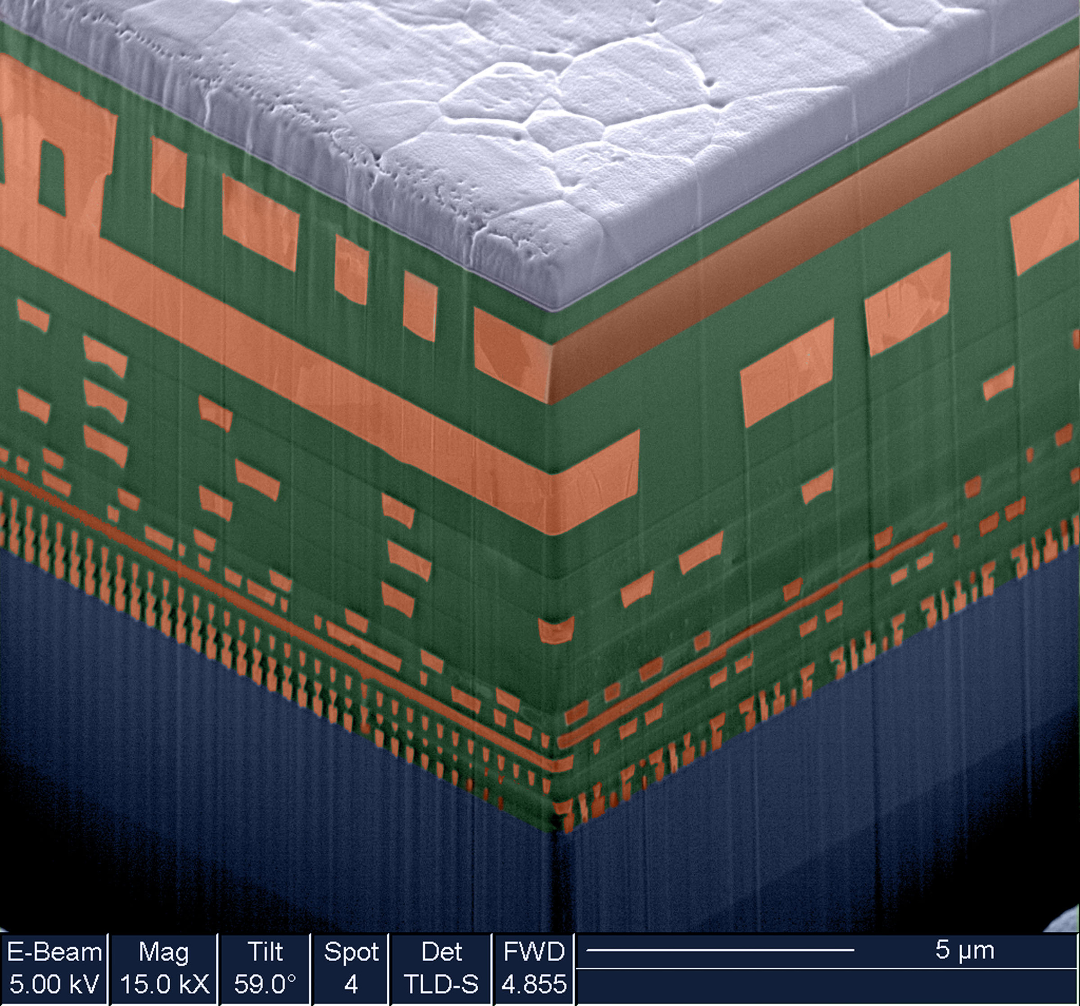
Chip Cross-Section (IBM 64-bit Microprocessor )
[Source IBM: https://www-03.ibm.com/press/us/en/photo/19014.wss ]
Notes:
This does not look like Verilog but it is, very likely, the end result of a HDL description.
Synthesis tools figure out devices required to implement behavior, where they go and how they are connected.

Slide 10
Today’s definition of Synthesis: Automatically creating an
optimized gate-level description from an RTL-level description:
Emerging definition of Synthesis: Automatically creating an optimized gate-level description from a behavioural description (e.g., compiling from C or C++ to gates can now be done to a limited extent using tools such as Xilinix Vivado and Intel FPGA SDK for OpenCL, which enable high level synthesis; Effective use still requires knowledge of hardware design)
Verilog Code
Notes:
Two inputs on right specified by project configuration in Quartus.
Input on left is what you spend most of your time worrying about. What is the process?

Slide 11
Design Flow
Design conception
Step 1: Describe System, e.g. “flow chart”, “requirements”.
Step 2: Think about the hardware you want to build! Consider which hardware building blocks are appropriate.
Step 3: Only then, write Verilog
WARNING: If you do step 3 without or before the other two, you are (very likely) going to end up with a circuit that does not work or only works “some of the time” (which is not good enough)
DESIGN ENTRY
Schematic
capture
Verilog
Synthesis
Functional simulation
No
Design correct?
Yes
Physical design
Timing simulation
No
Timing requirements met?
Chip configuration
B&V: Figure 2.29. A typical CAD system.
Notes:
Step 1: The lab handouts give you a specification. You’ll learn more about this step in CPEN 311.
Step 2 and 3 are the primary focus in CPEN 211. Don’t build a house starting from a periodic table of the elements you start with ingredients like wood, bricks, steel bars and concrete. Similarly, higher level than syntax. Design patterns.
After Step 3: Flowchart find and fix errors then go back and redo simulation.

Slide 12
Different Verilog Syntax & Styles
Verilog syntax as per IEEE standard
Verilog syntax allowed by tools
for simulation (e.g., ModelSim)
Verilog style allowed by
tools for synthesis
(e.g., Quartus)
Verilog style “recommended” to prevent common errors for synthesizable design entities
Text: Dally §Appendix
Notes:
Venn diagram. Each point is a string of keyboard characters. How to categorize these strings?
Are they valid Verilog and if so in which sense are they valid?

Slide 13
VERY Important
When you write synthesizable Verilog you are describing hardware behavior not software.
The CAD tools (e.g., Quartus) convert your Verilog into logic gates that implement the hardware.
The Field Programmable Gate Array (FPGA) on your DE1-SoC board does NOT “execute” your Verilog. The FPGA implements logic gates that have the same behavior as your Verilog.
Notes:
1.5

Slide 14
Verilog
Basic unit is a module
Modules have
Module declaration
Input and output declarations
Internal signal declarations
Logic definition
Assign statements
Case statements
Module instantiations
Notes:
Module describe a block of hardware. It is different from a function in a software programming language.

Slide 15

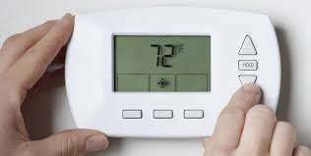

Example
[http://www.clipartpanda.com/categories/cute-house-clipart]
[http://blogs.plos.org/obesitypanacea/2011/02/25/turn-down-your-thermostat-to-lose-weight-suggests-new-study-dripping-with-sarcasm/]

Slide 16
Design Step
presetTemp
Thermostat
fanOn
currentTemp

Slide 17
Example, Verilog for Thermostat
module Thermostat(presetTemp, currentTemp, fanOn) ;
input [2:0] presetTemp, currentTemp ; // temperature inputs, 3 bits each
output fanOn ; // true when current > preset
wire fanOn ;
assign fanOn = (currentTemp > presetTemp) ;
endmodule
Text: Dally §1.5

Slide 18
Example, Verilog for Thermostat
Module declaration
I/O list
module Thermostat(presetTemp, currentTemp, fanOn) ;
input [2:0] presetTemp, currentTemp ; // temperature inputs, 3 bits each
output fanOn ; // true when current > preset
wire fanOn ;
assign fanOn = (currentTemp > presetTemp) ;
endmodule
Declare I/Os
3-bit wide signals
An assign statement defines a signal with an equation
A wire is a signal set with an assign statement or connected to a module
Text: Dally §1.5

Slide 19
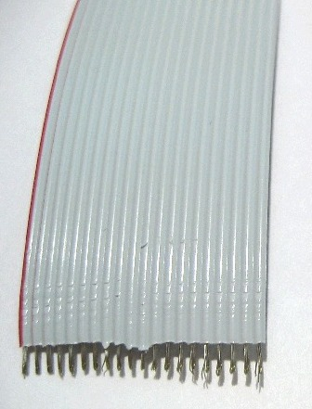
Wires and busses
Both sequential and combinational logic are built using wires and busses.
Single wire carries one bit (e.g., 0 V or 2.5 V for “0” or “1”)
If we want to send N bits (e.g., to represent one of 2^{N} temperatures) we need N wires. Often referred to as N-bit bus.
Schematic symbol:
20
// reg - write inside “always”
reg [19:0] my_bus_one;
// wire - write with “assign”
wire [19:0] my_bus_two;
Ribbon cable with 20 wires.
I.e., a 20-bit bus.
Notes:
1.5

Slide 20
When does each line of code “happen”?
module Thermostat(presetTemp, currentTemp, fanOn) ;
input [2:0] presetTemp, currentTemp ; // temperature inputs, 3 bits each
output fanOn ; // true when current > preset
wire fanOn ;
assign fanOn = (currentTemp > presetTemp) ;
endmodule
presetTemp
Thermostat
fanOn
currentTemp
presetTemp
010
011
currentTemp
010
001
fanOn
1
0
Time
Text: Dally §1.5
Notes:
All Verilog is compiled into hardware.
Then power is turned on and inputs and outputs change. So, assign statement is “always” operating.
Whenever an input do the assign statement changes, the output can change.

Slide 21
Example, Days in Month Function
DaysInMonth
month
days

Slide 22
Example, Days in Month Function
module DaysInMonth(month, days) ;
input [3:0] month ; // month of the year 1 = Jan, 12 = Dec
output [4:0] days ; // number of days in month
reg [4:0] days ;
always @(month) begin // evaluate whenever month changes
case(month)
2: days = 5'd28 ; // February has 28
4,6,9,11: days = 5'd30 ; // 30 days have September ...
default: days = 5'd31 ; // all the rest have 31...
endcase
end
endmodule

Slide 23
Example, Days in Month Function
module DaysInMonth(month, days) ;
input [3:0] month ; // month of the year 1 = Jan, 12 = Dec
output [4:0] days ; // number of days in month
reg [4:0] days ;
always @(month) begin // evaluate whenever month changes
case(month)
2: days = 5'd28 ; // February has 28
4,6,9,11: days = 5'd30 ; // 30 days have September ...
default: days = 5'd31 ; // all the rest have 31...
endcase
end
endmodule
Reg defines a signal set in an always block. It does NOT define a register.
Always block evaluates each time activity list changes. In this case each time month changes
Case statement selects statement depending on value of argument. Like a truth table.
Can have multiple values per statement
Default covers values not listed.
Text: Dally §7.1.2, 9.2

Slide 24
Verilog Literal Numbers
Verilog numbers can be expressed using:
<size>’[<signed>]<radix>value
<size> Number of bits.
<signed> Signed: s (if omitted unsigned)
<radix> Radix of the number:
b – binary
d – decimal
o – octal
h – hexidecimal
value Digits depend upon radix; Underscores ignored.
Example: 8’sb0001_1101

Slide 25
The Always Block
Two important things to know:
What an always block is (syntax and meaning)
Rules to ensure your always block Verilog code is synthesizable by CAD tools.

Slide 26
The always block allows us to describe the function or behaviour of a circuit or subcircuit without describing the actual hardware
We have already seen some sorts of behavioural descriptions:
assign fanOn = (currentTemp > presetTemp) ;
This describes the behaviour of the circuit driving “fanOn” without necessarily specifying the actual hardware implementation
But we are going to take this MUCH further and describe circuits
at a much higher level.

Slide 27
How can we describe behaviour?
If we could write an English description, that would be nice
- but English gives too much room for ambiguity
A better way: describe the behaviour using something that has a notion of order between statements – somewhat like software
- writing software is easy
- no room for ambiguity
Verilog provides a syntax we’ll learn next that makes describing behavior easier.
NOTE: The always block syntax only describes the behaviour of the circuit, not how the circuit is constructed. It is NOT software. We still need to think about what hardware we are trying to describe. There are limits to the Verilog the CAD tools can “synthesize” into hardware. We will learn some simple “rules” to ensure we write Verilog that is synthesizable (turns into hardware that works as we expect) as we learn more about different types of circuits you may want to describe.

Slide 28
Always Block Syntax and Semantics
always @(sensitivity_list) begin
sequence of statements in which order matters
end
- Each always block describes the function of one block of hardware.
- When a signal in the sensitivity list changes, statements inside the always block are immediately & instantaneously evaluated one after the other in
order starting from the beginning of the always block.
- The sensitivity list is NOT the same thing as the input parameters to
a function (in a language like “C” or Java, or C++). It does NOT pass
values into the always block. The sensitivity list determines when the
sequence (list) of statements inside the always block will be “processed”.
NOTE: The “description” in the always block may have little resemblance to the actual hardware implementation. However, provided you follow certain rules the hardware will implement the same behavior.

Slide 29
Verilog design style – for synthesizable modules
Combinational modules use only
Assign statements
Case or Casex statements (with default)
If statements – only if all signals have a default assignment
Instantiations of other combinational modules
Sequential modules use only
Combinational logic
Explicitly declared registers (flip-flops)
Do not use
Loops
Always blocks except for case, casex, or if
Do use
Signal concatenation, e.g., {a, b} = {c, d}
Signal subranges, e.g., a[7:1] = b[6:0] ;
Logic is organized into small modules
Leaf modules not more than 40 lines
If it could be made two modules, it should be
Text: Dally §Appendix

Slide 30
Verilog design style – for synthesizable modules (page 2)
Use lots of comments
Comments themselves
Meaningful signal names – tempHigh, not th
Meaningful module names – DaysInMonth, not Mod3
Activation lists for case statements include ALL inputs (or use *)
Constants
All constants are `defined if used more than once
Width of all constants is specified 5’d31, not 31
Signals
Buses (multi-bit signals) are numbered high to low
e.g., wire [31:0] bus
All signals should be high-true (except primary inputs and outputs)
Visualize the logic your Verilog will generate.
If you can’t visualize it, the result will not be pretty
Text: Dally §Appendix

Slide 31
All synthesizable Verilog examples presented in CPEN 211 slides and digital design textbook conform to this style except where noted.
This style is used in industry (e.g., similar to styled used inside NVIDIA).

Slide 32
Learning Verilog in CPEN 211
So, now you sort of “know” a little Verilog.
Full Verilog language specification is 879 pages!
In CPEN 211 we learn only “most useful subset”.
However, to use Verilog effectively, you need to know digital hardware design theory.
Hence, in CPEN 211 we will present Verilog syntax and style AFTER first introducing relevant digital hardware design theory.
Feel free to consult online syntax guidelines to learn more but you must follow style guidelines!

Slide 33
Getting electrons to solve problems…
Problem
?
Devices (electrons)
Notes:
3
Slide courtesy: Prof. Yale Patt, Univ. of Texas at Austin
Problem: Compute list of suggested friends on facebook
Algorithm: Search social graph
Program: Algorithm to perform search… operating system you run the program on (Linux)
ISA: x86-64-bit
Microarchitecture: Pipelined, superscalar, out-of-order and speculative execution
Circuits: AND, OR, NOT; Half-adder, priority encoder, flip-flops, counters, registers, SRAM, DRAM, etc…
Electronic Devices: fin-FET CMOS

Slide 34
[http://www.clipartpanda.com/categories/cute-house-clipart]
[http://blogs.plos.org/obesitypanacea/2011/02/25/turn-down-your-thermostat-to-lose-weight-suggests-new-study-dripping-with-sarcasm/]

Slide 35

[By Fir0002 - Own work, GFDL 1.2, https://commons.wikimedia.org/w/index.php?curid=2380067]
Electrons accelerated by electric field.
Electric field generated by voltage differences.
Notes:
1.5

Slide 36
How to turn problem into voltages?
Analog approach: Use voltage to directly encode information
Example: Voltage = 0.2(Temperature − 68)
72.5 °F represented by …?
Text: Dally §1.2
Notes:
1
Need to process, transport and store information.

Slide 37
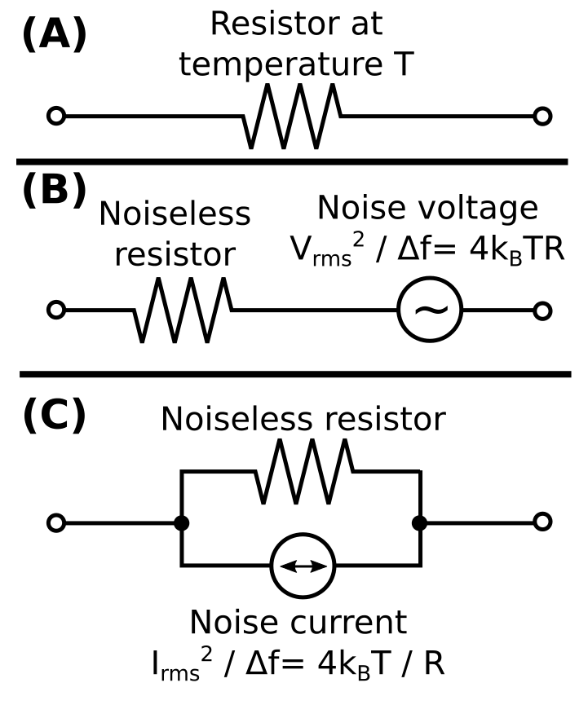
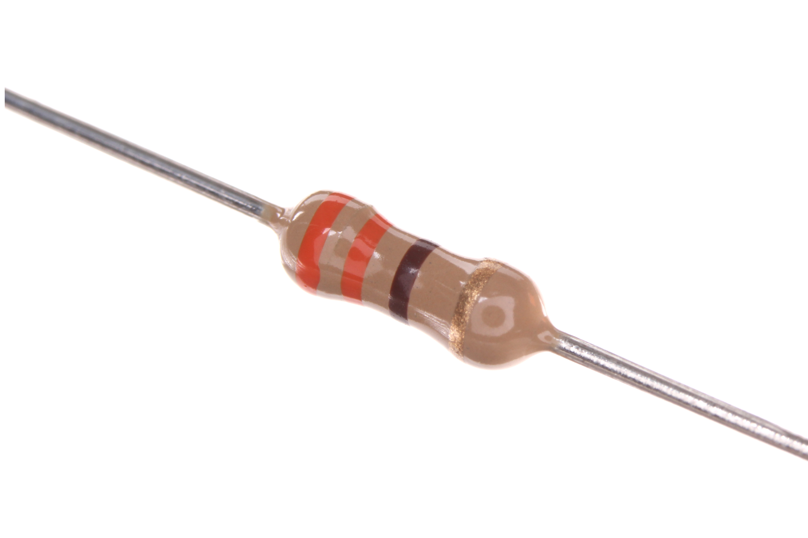
Fun Fact: Thermal Noise
You do NOT need
to know this
formula ☺
All wires have some resistance so they will have some amount of “noise”.
Resistor image: By oomlout (RESE-W04-X-O331-01) [CC BY-SA 2.0 (http://creativecommons.org/licenses/by-sa/2.0)], via Wikimedia Commons from Wikimedia Commons
Circuit Image: By Sbyrnes321 - Own work, CC0, https://commons.wikimedia.org/w/index.php?curid=28181783

Slide 38


Effect of Noise on Analog Signals
Voltage
Noise
Time
ε
Error at Output
V
V+
ε
f(V+
ε)
Input
+
f
Output
Noise added to Input
✘
y
(output)
f(x) = 2⋅x
x
E.g., disturb temperature by ε=100mV, new temperature signal is 1V which corresponds to 73 degrees instead of 72.5
(input)
Text: Dally §1.2
Notes:
2
E.g., disturb temperature by 100mV, new temperature is 1V which corresponds to 73 degrees instead of 72.5

Slide 39
Effect of Noise on Digital Signals
Voltage
Voltage
Noise
Time
Time
ε
V
V
+
ε
f(V
)
Input
1
+
1
f
1
Output
Restoration: Output is identical to Input despite
noise!
y
f(x)
(output)
x
(input)
Text: Dally §1.2
Notes:
1

Slide 40
Effect of Nonlinear Function “f”
y
f(x)
x
Voltage
Time
Input + Noise
V
+
ε
1

Slide 41
Effect of Nonlinear Function “f”
Output
f(V
)
1
y
f(x)
Voltage
x
Time
Voltage
Time
Input + Noise
V
+
ε
1
Why is this useful?
For example, if 72 degrees represented by 010, small noise leaves signal as 010.

Slide 42
Buffer
y
f(x)
x
Buffer

Slide 43
Avoiding Errors by “Going Digital”
Alternative to Analog: detect presence or absence of a voltage – i.e., digital binary.
Binary, meaning two, simpler than differentiating more than two voltages
Digital, meaning discrete, provides noise immunity.
Today’s systems move from analog to digital as soon as possible.
We will use positive logic: Higher voltage means ‘1’ (“true”) low voltage means ‘0’ (“false”)
Text: Dally §1.2
Notes:
2

Slide 44
What is the impact of noise on large circuits?

Slide 45
Noise Accumulation
Voltage
Noise
Noise
Noise
Time
ε
ε
ε
1
2
3
V
V
+
ε
1
V
+
ε
1
+ε
2
V
+
ε
1
+ε
2
+ε
3
a
+
a
+
a
+
a
The more analog circuits we combine the more noise accumulation impacts the output.
Text: Dally §1.2

Slide 46
Signal Restoration
y
f(x)
(output)
x
(input)
Noise
Noise
Noise
ε
ε
ε
1
2
3
V
V
+
ε
1
V
V
+
ε
2
V
V
+
ε
3
V
a
+
a
a
+
a
a
+
a
a
Voltage
Voltage
Voltage
Voltage
Time
Time
Time
Time
Restoration enables LARGE digital circuits to carry out complex, high-precision operations.
Text: Dally §1.2
Notes:
Here “a” is 0 or 1.
Digital systems process, transport, and store information without it being distorted by noise because they periodically *restore* a degraded 1 or 0 back to a clean 1 or 0 before an error accumulates and becomes larger than noise margin.

Slide 47
Noise Accumulation
Voltage
Noise
Noise
Noise
Time
ε
ε
ε
1
2
3
V
V
+
ε
1
V
+
ε
1
+ε
2
V
+
ε
1
+ε
2
+ε
3
a
+
a
+
a
+
a
y
f(x)
(output)
Signal Restoration
Buffer
x
Voltage
Voltage
(input)
Noise
Noise
Noise
Time
Time
ε
ε
ε
1
2
3
V
V
+
ε
1
V
V
+
ε
2
V
V
+
ε
3
V
a
+
a
a
+
a
a
+
a
a
Restoration enables LARGE digital circuits to carry out complex, high-precision operations.
Text: Dally §1.2

Slide 48
Characteristics of a “Buffer” Circuit
y
f(x)
x
Buffer

Slide 49
“1”
“1”
“1”
“1”
“0”
“0”
H
W
“0”
“0”
H
Slope > 1 here
W
H
To tolerate noise: H < W.
Slope > 1 means buffer “gain” must be greater than one. => Need “active” element.

Slide 50
“1”
“1”
“1”
“1”
“0”
“0”
“0”
“0”

Slide 51


“Beacon of Gondor” Analogy (Lord of the Rings)
“1”
“1”
“1”
“1”
“0”
“0”
H
W
“0”
“0”
H
Video: https://www.youtube.com/watch?v=i6LGJ7evrAg
“Gondor sends a signal to Rohan asking them for military aid”
[Analysis of fictional speed of propagation: http://scienceblogs.com/dotphysics/2010/07/30/how-fast-is-the-beacon-of-gond/ (photos above from this URL)]

Slide 52
Voltage Ranges of Binary Signals
For example, 2.5V LVCMOS logic, all voltages between V_{min}=-0.3V and V_{IL} = 0.7V represent logic value of “0”.
Damage
0
?
1
Damage
V_{min}
V₀
V_{IL}
V_{IH}
V₁
V_{max}
Voltage
-0.3V
0.0V
0.7V
1.7V
2.5V
2.8V
2.5V LVCMOS Logic
A “standard” set of voltages. Defined by an industry standards organization called JEDEC.
Text: Dally §1.1
Notes:
1.5

Slide 53
Noise Margin
Voltage
V_{max}
Key to restoration: Output range for “1” narrower than input range for “1”. This provides noise margin.
Similarly, output range for “0” narrower than input range for “0”.
V₁
V_{OH}
V_{NMH}
V_{IH}
0
Tran
0
Tran
Damage
?
Damage
V_{IL}
V_{OL}
V_{NML}
V₀
V_{min}
Text: Dally §1.2
Notes:
2

Slide 54

Example (Supply Noise)
Two chips, A and B, use the 2.5V LVCMOS encoding to send logic signals from A to B:
A
B
2.5V LVCMOS
Suppose there is a voltage shift between the two chip’s power supplies so that all voltages in A are V_{N} higher in B.

Slide 55
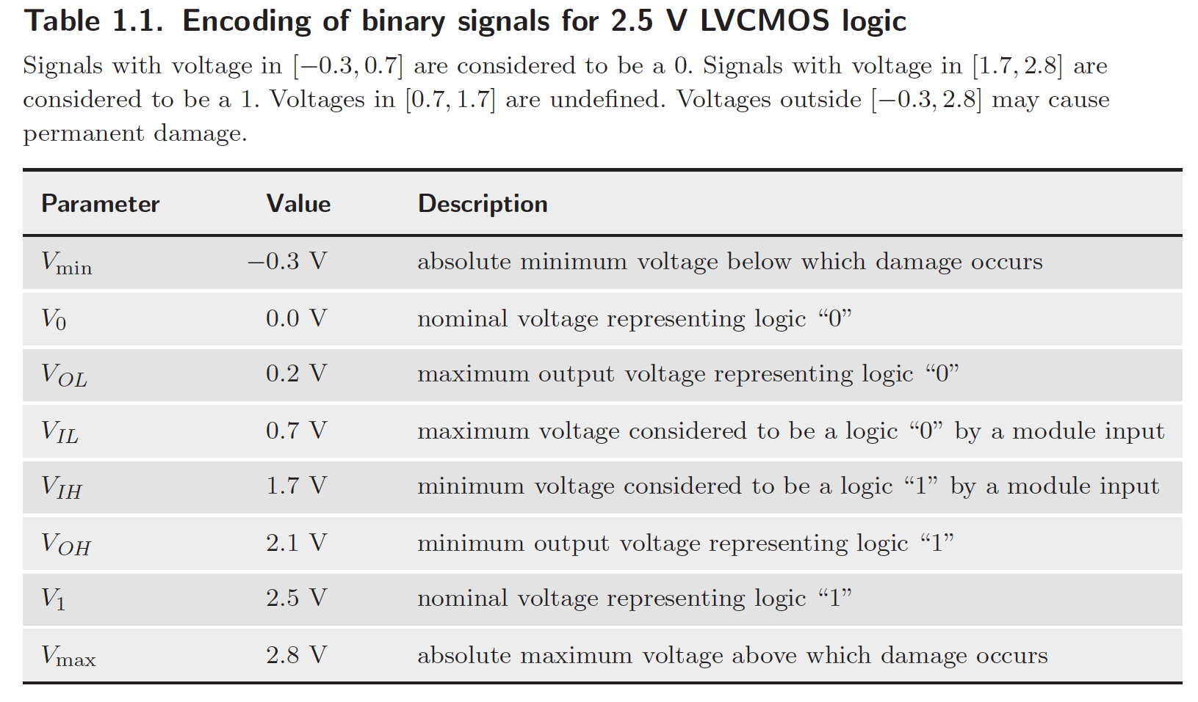
A voltage of V_{x} in system A appears as a voltage of V_{x} + V_{N} in system B. Assuming no other noise sources, what is the maximum value of V_{N} for which the system operates properly?
Chip B
Chip A
V_{max} = 2.8V
V_{N}
V_{dd} = 2.5V
V_{OH} = 2.1V
V_{IH} = 1.7V
(a) V_{dd}+ V_{N} <= V_{max} AND
(b) V_{OL}+ V_{N} <= V_{IL}
(a) 2.5V + V_{N} <= 2.8V AND
(b) 0.2V + V_{N} <= 0.7V
(a) V_{N} <= 0.3V AND
(b) V_{N} <= 0.5V
V_{N} <= 0.3V
0
Tran
Damage
?
Damage
V_{IL} = 0.7V
V_{OL} = 0.2V
V_{N}
V_{GND} = 0V
V_{min} = -0.3V

Slide 56

Representing Information
By gnuckx (A red rose for Elena - Creative Commons by gnuckx)
[CC BY 2.0 (http://creativecommons.org/licenses/by/2.0)],
via Wikimedia Commons from Wikimedia Commons
“What's in a name? that which we call a rose
By any other name would smell as sweet”
[William Shakespeare, Romeo and Juliet]
Notes:
Earlier we said we would represent “false” with a low voltage and “true” with a high voltage.
It is important to recognize that in some sense the choice of associating a low voltage or logic level 0 with “false” is arbitrary. It is not unlike associating the English word “rose” with the plant shown above. However, the choice can have an impact on how easy it is to operate on the information.
Another issue that arises with digital representations is the number of different things we can represent. For the picture on the left each pixel can only be black or white. For the picture on the right, each pixel can take on any one of millions of different colors.

Slide 57
Representing Information
Earlier saw we could represent temperature with a voltage:
Voltage = 0.2(Temperature − 68)
0.9 V represents 72.5 °F
Also saw we could represent a binary value with a voltage:
0 V represents “0”
2.5 V represents “1”
Two separate things:
The information we are interested in.
The representation of that information.
Let’s consider how to represent information in binary…

Slide 58




With 0 and 1 we can represent two things
A description is “True” or “False”
Door “open” or “closed”
light “on” or “off”
Text: Dally §1.3
Notes:
1.5

Slide 59
Often deal with information that is NOT “binary”
Element of a set: E.g., colors
 | White
 | Red
 | Blue
 | Yellow
100
101
110
111
000
001
010
011
 | Purple
 | Orange
 | Green
 | Black
With k “bits” we can represent at most 2^{k} different things.
Text: Dally §1.3

Slide 60
Often deal with information that is not binary:
Continuous Quantities: E.g., temperature
[http://blogs.plos.org/obesitypanacea/2011/02/25/turn-down-your-thermostat-to-lose-weight-suggests-new-study-dripping-with-sarcasm/]
000 | 68
001 | 70
010 | 72
011 | 74
100 | 76
101 | 78
110 | 80
111 | 82
0000000 | 68
0000001 | 70
0000011 | 72
0000111 | 74
0001111 | 76
0011111 | 78
0111111 | 80
1111111 | 82
Text: Dally §1.3
Notes:
1

Slide 61
We pick a binary representation (name) based on the operations required

Slide 62
Example

Slide 63
Pick representation of colors to support the operation of “subtractive” color mixing
No colors - white
Primary colors – red, blue, yellow
Derived colors – orange, purple, green, black
How to represent individual colors if we want to efficiently compute result of combining colors?
Binary
Encoding
Binary
Encoding
Meaning
Meaning
000 | White
 | Red
 | Blue
 | Yellow
001
010
100
101
110
111
 | Purple
 | Orange
 | Green
 | Black
011
Text: Dally §1.3
Notes:
2

Slide 64



How would you represent
A Date ?
Days since Jan 1 0000 (20 bits)
Month, day, year (4 + 5 + 12 bits)
Month, day, year, day of week (4 + 5 + 12 + 3 bits)
A playing card ?
Number in deck (6 bits)
Suit, Number (2 + 4 bits)
Decoded suit, decoded number (4 + 13 bits)
A 5-card hand?
Text: Dally §1.3
Notes:
735,110 days ; 2^20 = 1,048,576
12 months, requires 4-bits (16)
31 days in month, requires 5-bits (32)
How many years? 11-bits 2048, 12-bits 4096

Slide 65


Representing Numbers
Many ways to represent same value
E.g., number five can be written as “5”.
Hand with fingers+thumb extended.
Unary encoding: 11111 or . Used for counting birthdays (candles on cake).
Will see binary representation for five is 101
Will also see (in 2-3 weeks) floating-point
IMPORTANT: Digital logic always uses 0’s and 1’s. Decimal numbers in Verilog are converted to 0’s and 1’s by Quartus during synthesis.
Notes:
2

Slide 66
Unsigned (non-negative) Integers
Unsigned integers useful for counting
Example 1: Track number of times we have completed a task.
Example 2: Identify different memory locations (e.g., 129 Main St. vs 131 Main St.)
Text: Dally §10.1
Notes:
1.5

Slide 67
Unsigned Integers in Binary
Decimal: E.g., 329 = 3×10² + 2×10¹ + 9×10⁰
binary digits are 0 and 1
E.g., with five bits, represent number 6 as 00110
This means 0×2⁴ + 0×2³ + 1×2² + 1×2¹ + 0×2⁰
0×16 + 0×8 + 1×4 + 1×2 + 0×1
Text: Dally §10.1
Notes:
2

Slide 68
Converting from Decimal to Binary
Expand, convert, evaluate (not recommended)
329 = 3×10² + 2×10¹ + 9×10⁰
= 11×1100100 + 10×1010 + 1001x1
= 101001001
2. Division by 2 method
If least significant decimal digit is odd (even), then least significant binary digit is 1 (0).
329 (odd) => 1, 329 ÷ 2 =
164 (even) => 0, 164 ÷ 2 =
82 (even) => 0, 82 ÷ 2 =
41 (odd) => 1, …
Subtraction method (see text: Dally 10.1)
Text: Dally §10.1
Notes:
2.5

Slide 69
Apple A8 die photo
(application processor
used in iPhone 6)
[http://vlsiarch.eecs.harvard.edu/accelerators/die-photo-analysis]

Slide 70


Two Types of Digital Logic!
“Sequential Logic”
“Combinational Logic”
remembers things…
forgets things…

Slide 71
Wires and busses
Both sequential and combinational logic are built using wires and busses.
Single wire carries one bit (e.g., 0 V or 2.5 V for “0” or “1”)
If we want to send N bits (e.g., to represent one of 2^{N} temperatures) we need N wires. Often referred to as N-bit bus.
Schematic symbol:
20
// reg - write inside “always”
reg [19:0] my_bus_one;
// wire - write with “assign”
wire [19:0] my_bus_two;
Ribbon cable with 20 wires.
I.e., a 20-bit bus.
Notes:
1.5

Slide 72
Combinational Logic Circuit
Present output is a function of present input
Past input values do NOT matter
Example – digital thermostat
000 | 68
001 | 70
010 | 72
011 | 74
Means this signal is 3-bits wide
Text: Dally §1.4
Notes:
1.5

Slide 73
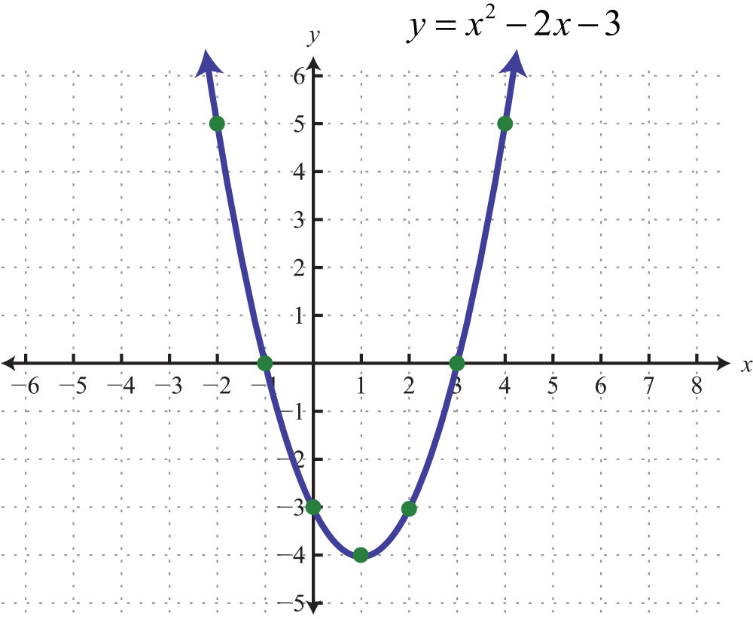
Recall: Functions
y is “output”
“x” is input
[http://2012books.lardbucket.org/books/beginning-algebra/s12-05-graphing-parabolas.html]

Slide 74
Combinational logic implements a memoryless function
output = f(input)
input output
i₁ i₂ i₃ | o₁
0 0 0 | 0
0 0 1 | 0
0 1 0 | 0
0 1 1 | 1
1 0 0 | 0
1 0 1 | 1
1 1 0 | 1
1 1 1 | 1
instead of “real” numbers
combinational logic
uses “binary"
[http://2012books.lardbucket.org/books/beginning-algebra/s12-05-graphing-parabolas.html]
Text: Dally §6.1
Notes:
1.5

Slide 75


Sequential Logic
Combinational Logic
combination = R31-L23-R0
Current output (locked/unlocked) depends upon past inputs
Current output (locked/unlocked) depends
only on current inputs
Notes:
1.5

Slide 76
Sequential logic circuits
Includes state (memory, storage)
Makes output a function of history as well as current inputs
Synchronous sequential logic uses a clock
Example: A calendar circuit that remembers current date and updates the date each morning.
September = 9₁₀ = 1001₂
9th day = 9₁₀ = 1001₂
Wednesday = 3 = 011₂
September = 9₁₀ = 1001₂
10th day = 10₁₀ = 1010₂
Thursday = 4 = 100₂
Text: Dally §1.4
Notes:
2

Slide 77
Building Larger Circuits

Slide 78
[http://www.clipartpanda.com/categories/cute-house-clipart]
[http://blogs.plos.org/obesitypanacea/2011/02/25/turn-down-your-thermostat-to-lose-weight-suggests-new-study-dripping-with-sarcasm/]

Slide 79
Can compose digital circuits
Text: Dally §1.4
Notes:
2
Suppose we want to modify our thermostat so that the fan does not run on Sundays.
Important part of digital design is partitioning up a design into smaller portions. In 259 we study in detail an example which is the digital system inside a computer.

Slide 80
Closure
(Set Theory) Combinational logic circuits are “closed” under “acyclic composition”
In plain English: If we combine two combinational logic circuits without introducing a cycle, the resulting circuit will also be combinational.
CL1
CL2
CL12
Text: Dally §6.2
Notes:
1.5

Slide 81
Text: Dally §6.2
Notes:
1

Slide 82
How to design combinational logic?

Slide 83
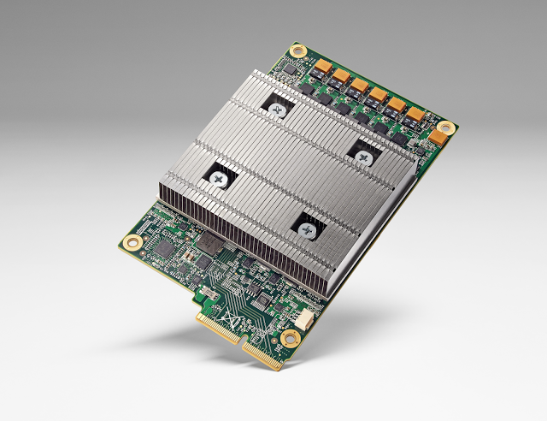
Google Tensor Processing Unit (TPU)
[Image Source: https://cloudplatform.googleblog.com/2016/05/Google-supercharges-machine-learning-tasks-with-custom-chip.html]

Slide 84

Deep Learning: Where Times Goes
~ 90% of time → dot products
X
+
100s
-
1000s
X
More details: http://www.ece.ubc.ca/~aamodt/papers/Cnvlutin.ISCA2016.pdf

Slide 85
Design Steps
Describe desired functionality (e.g., Verilog)
Minimize cost of implementation (e.g., Quartus)

Slide 86
Several ways to describe a combinational logic function
Example – “Majority Circuit”
English Language Description
Outputs 1 if more inputs are 1 than are 0
Truth table
Logic equation (Boolean algebra)
q = (a ∧ b) ∨ (a ∧ c) ∨ (b ∧ c)
abc | q
000 | 0
001 | 0
010 | 0
011 | 1
100 | 0
101 | 1
110 | 1
111 | 1
Notes:
2

Slide 87
Why Boolean Algebra?
If a truth table can completely describe a combinational logic function, why do we need logic equations and Boolean algebra?
Two reasons:
Easy to convert from a logic equation to circuit
We can use the “laws of Boolean algebra” to simplify the circuit to save cost

Slide 88
Several ways to describe a combinational logic function
Logic gate diagram
Verilog
assign f = (a&b)|(a&c)|(b&c);

Slide 89
Boolean Algebra
“high school” Algebra:
Algebra over infinite set – e.g., real numbers (-∞, ∞)
4 operators: Multiplication (*), addition (+), subtraction (-), division (÷)
Boolean Algebra:
algebra over 2 element set: {0,1}
3 operators: AND (∧), OR (∨), NOT (¬)
Text: Dally §3 (1st page intro)
Notes:
1.5

Slide 90
Boolean Algebra
AND Operation (“conjunction”)
Definition: a ∧ b = 1 if and only if a=1 and b=1
Similar to English definition of “and”.
OR Operation (“disjunction”)
Definition: a ∨ b = 1 if a=1 or b=1
Similar to English definition of “or” but note that a ∨ b is “1” when both a=1 and b=1.
NOT Operation:
Definition: ¬a = 1 iff a=0
Text: Dally §3 (1st page intro)
Notes:
“NOT a” can also be written as a with a bar over it or a’

Slide 91
Boolean Algebra
Truth tables defining AND, OR and NOT:
a | b | a^b | a v b
0 | 0 | 0 | 0
0 | 1 | 0 | 1
1 | 0 | 0 | 1
1 | 1 | 1 | 1
a | ~a
0 | 1
1 | 0
Text: Dally §3 (1st page intro)
Notes:
1.5

Slide 92
Note on Notation
For AND logic function:
use ∧
don’t use x nor .
For OR logic function:
use ∨
don’t use +
This avoids confusion between Boolean algebraic rules and rules of “normal” arithmetic.
Text: Dally §3 (1st page intro)
Notes:
1.5

Slide 93
Axioms of Boolean Algebra
Axioms: a set of mathematical statements that we assert to be true.
Annihilation:
0 ∧ x = 0
1 ∨ x = 1
Identity:
1 ∧ x = x
0 ∨ x = x
Negation:
¬0 = 1
¬1 = 0
Text: Dally §3.1
Notes:
2

Slide 94
Example: Absorption
Prove that x ∧ (x ∨ y) = x by using perfect induction (i.e., enumerate all the possibilities).
(We will fill this in during class)

Slide 95
Example: DeMorgan’s Law
Prove that ¬(x ∧ y) = ¬x ∨ ¬y by using perfect induction (i.e., enumerate all the possibilities).
x | y | x ∧ y | ¬(x ∧ y) | ¬x | ¬y | ¬x ∨ ¬y
0 | 0 | 0 | 1 | 1 | 1 | 1
0 | 1 | 0 | 1 | 1 | 0 | 1
1 | 0 | 0 | 1 | 0 | 1 | 1
1 | 1 | 1 | 0 | 0 | 0 | 0
Text: Dally §3.2
Notes:
1.5

Slide 96
Principle of Duality
If a Boolean equation is true, then substituting ∧ for each ∨, ∨ for each ∧, 1 for each 0, and a 0 for each 1 results in an equation that is also true.
Since it holds for axioms (dual of “0 ∧ x = 0” is “1 ∨ x = 1” which is also an axiom) it also holds for rest of Boolean algebra.
Text: Dally §3.1
Notes:
1.5

Slide 97
Dual Functions
Dual of logic function f, is function f^{D} derived from f by substituting a ∧ for each ∨, a ∨ for each ∧, a 1 for each 0, and a 0 for each 1.
Useful property for understanding CMOS gates: dual of a function applied to the complement of the input variables equals the complement of the function.
Text: Dally §3.3
Notes:
1

Slide 98
Example of
f(x,y) = (x ∧ 1) ∨ (0 ∨ ¬ y)
f^{D}(x,y) = (x ∨ 0) ∧ (1 ∧ ¬ y)
f^{D}(¬ x, ¬ y) = (¬ x ∨ 0) ∧ (1 ∧ y)
x | y | (x ∧ 1) | (0 ∨ ¬y) | f(x,y) | f(x,y) | (¬x ∨ 0) | (1 ∧ y) | f^{D}(¬x, ¬y)
0 | 0 | 0 | 1 | 1 | 0 | 1 | 0 | 0
0 | 1 | 0 | 0 | 0 | 1 | 1 | 1 | 1
1 | 0 | 1 | 1 | 1 | 0 | 0 | 0 | 0
1 | 1 | 1 | 0 | 1 | 0 | 0 | 1 | 0

Slide 99
Useful Boolean Properties
All properties below can be derived from the axioms.
Useful for simplifying Boolean expressions to use less operations => reduce cost.
Communicative | x ∧ y = y ∧ x | x ∨ y = y ∨ x
Associative | x ∧ (y ∧ z) = (x ∧ y) ∧ z | x ∨ (y ∨ z) = (x ∨ y) ∨ z
Distributive | x ∧ (y ∨ z) = (x ∧ y) ∨ (x ∧ z) | x ∨ (y ∧ z) = (x ∨ y) ∧ (x ∨ z)
Idempotence | x ∧ x = x | x ∨ x = x
Absorption | x ∧ (x ∨ y) = x | x ∨ (x ∧ y) = x
Combining | (x ∧ y) ∨ (x ∧ ¬y) = x | (x ∨ y) ∧ (x ∨ ¬y) = x
DeMorgan’s | ¬(x ∧ y) = ¬x ∨ ¬y | ¬(x ∨ y) = ¬x ∧ ¬y
Highlighted = different relations than for + and ✕ with real numbers
Text: Dally §3.2
Notes:
2

Slide 100
Example
Reduce the following Boolean expression to a minimum number of literals:
f(a,b,c) = (a ∧ c) ∨ (a ∧ b ∧ c) ∨ (¬a ∧ b ∧ c) ∨ (a ∧ b ∧ ¬c)

Slide 101
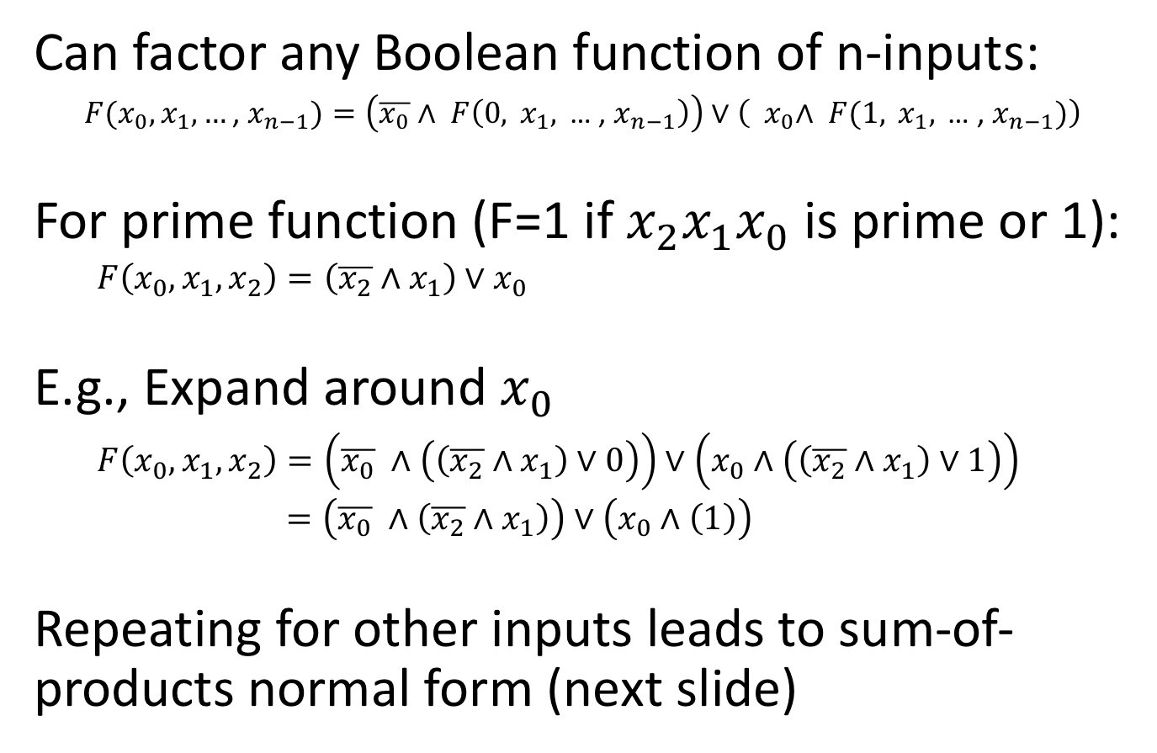
Shannon Expansion
Can factor any Boolean function of n-inputs:
$F(x_{0},x_{1},…\text{, }x_{n−1})=\left(\overline{x_{0}}∧ F\left(0, x_{1},\text{ … , }x_{n−1}\right)\right)∨\left({ x}_{0}∧ F(1, x_{1},\text{ … , }x_{n−1})\right)$
For prime function (F=1 if ${x_{2}x}_{1}x_{0}$ is prime or 1):
$F\left(x_{0},x_{1},x_{2}\right)=\left(\overline{x_{2}}∧x_{1}\right)∨x_{0}$
E.g., Expand around $x_{0}$
$F\left(x_{0},x_{1},x_{2}\right)=\left(\overline{x_{0}} ∧\left(\left(\overline{x_{2}}∧x_{1}\right)∨0\right)\right)∨\left(x_{0}∧\left(\left(\overline{x_{2}}∧x_{1}\right)∨1\right)\right)$
$=\left(\overline{x_{0}} ∧\left(\overline{x_{2}}∧x_{1}\right)\right)∨\left(x_{0}∧\left(1\right)\right)$
Repeating for other inputs leads to sum-of-products normal form (next slide)

Slide 102
Normal Form
Can also compare Boolean expressions for equality by reducing to a normal form.
Two types of normal form: sum of product, product of sums
A product term is boolean expression with any number of inputs or their complement AND’ed together. E.g., a ∧ ¬b.
In sum of products normal form each product term corresponds to single row in truth table with a ‘1’ output.
Input variable complemented if zero in truth table.
Normal form => products in same order as in truth table.
E.g., for majority circuit:
abc | q
000 | 0
001 | 0
010 | 0
011 | 1
100 | 0
101 | 1
110 | 1
111 | 1
Text: Dally §3.4
Notes:
3

Slide 103
Example
Rewrite the following Boolean expression in normal form: f(x, y, z) = 1 if exactly 0 or 2 inputs are 1.
xyz | f
000
001
010
011
100
101
110
111

Slide 104
Summary
The world is digital
Systems are digital at their core, only analog on the edges
Representing information
Binary signals, sets, continuous values
Digital signals reject noise
Voltage range divided into discrete states
Noise margins
Combinational logic
Output depends only on input (no state)
Boolean algebra
Rules to manipulate logic equations
Verilog
Describe hardware for simulation and synthesis

